Slide 10
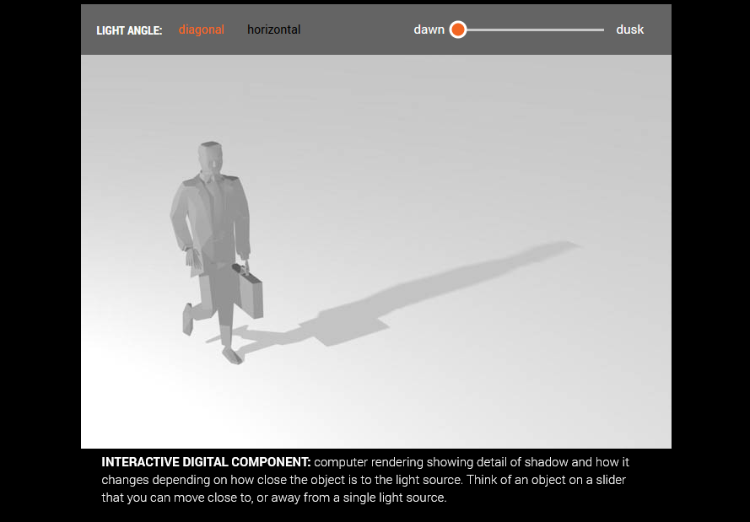
To see the live interactive module, click here

